Slide 1




Python - Exceptions

Slide 2
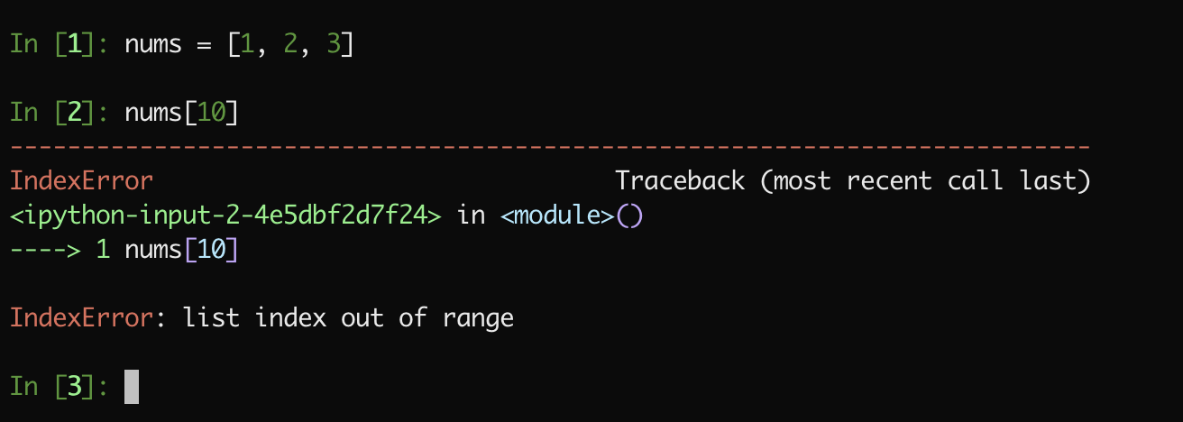
Errors - Exception
https://docs.python.org/3/library/exceptions.html

Slide 3
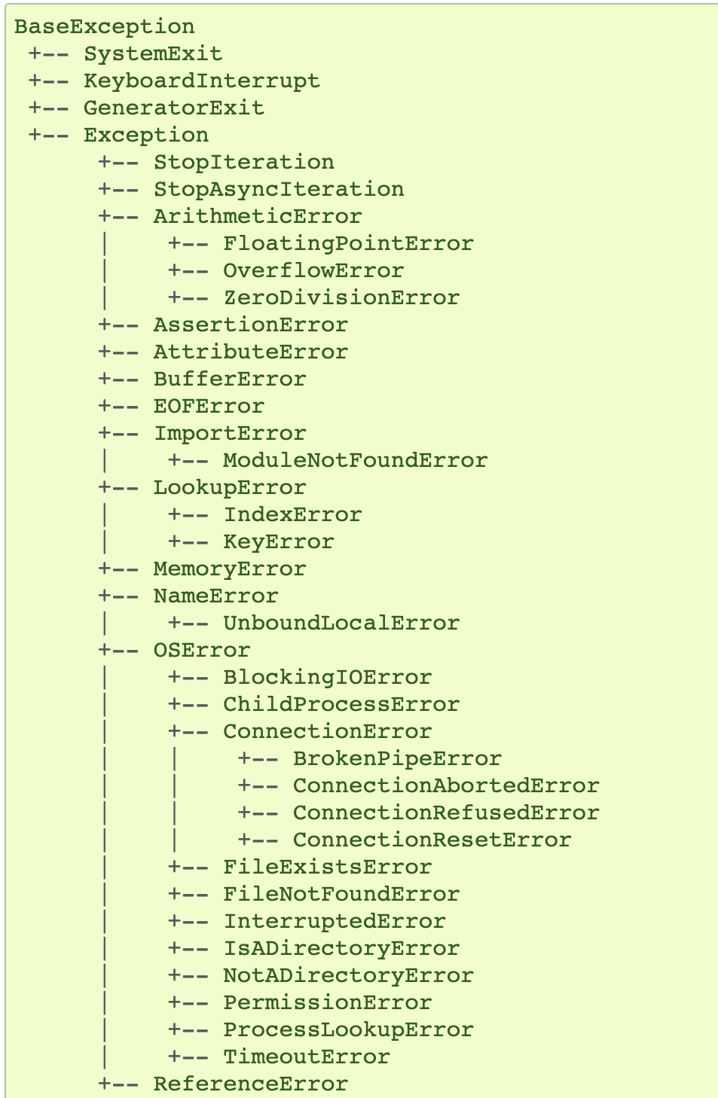
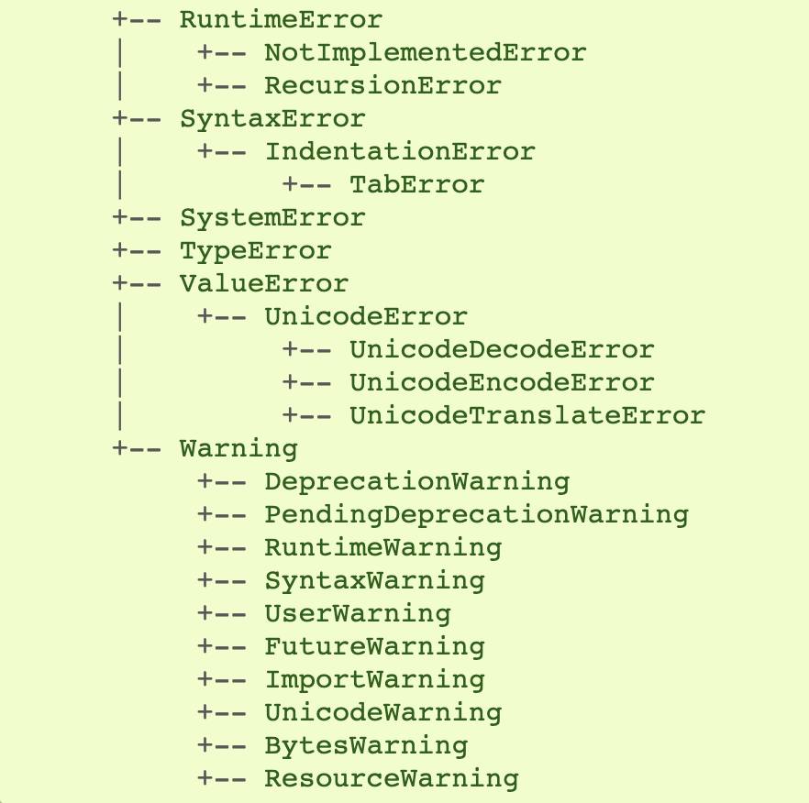
Exception hierarchy

Slide 4
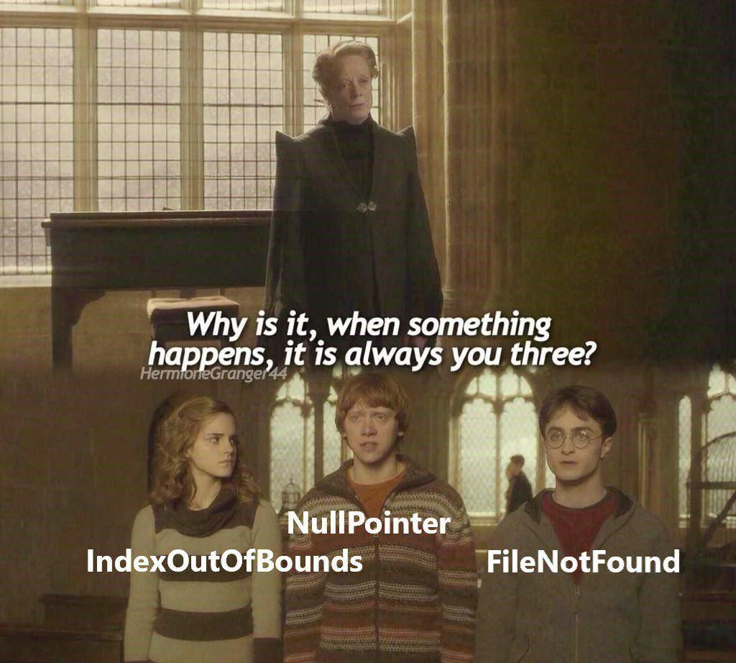
Top 3 Exceptions:
IndexError, TypeError, FileNotFoundError

Slide 5
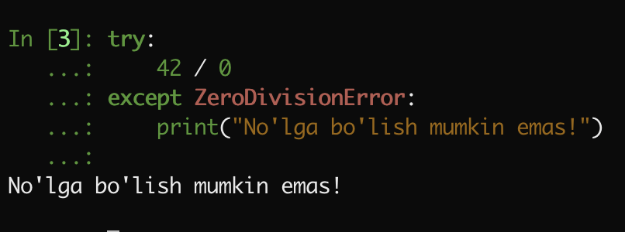
Kechirimli bo’lish - Try / Except
https://docs.python.org/3/library/exceptions.html

Slide 6
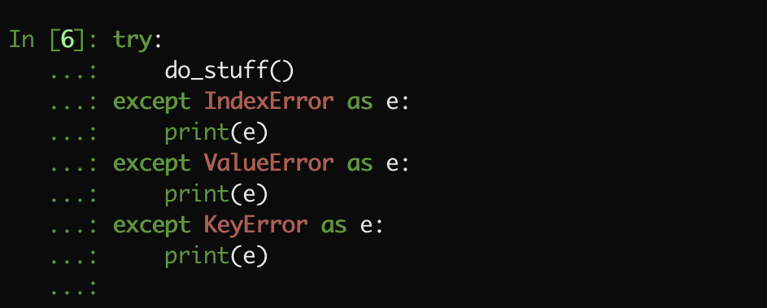
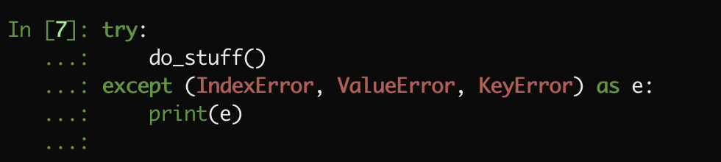
Bir vaqtni o’zida bir nechta except qilish

Slide 7
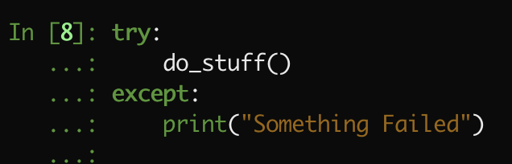
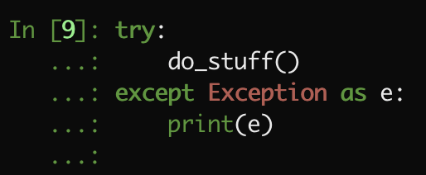
Barcha Errorlarni Except qilish

Slide 8
Barcha Errorlarni Except qilish

Slide 9
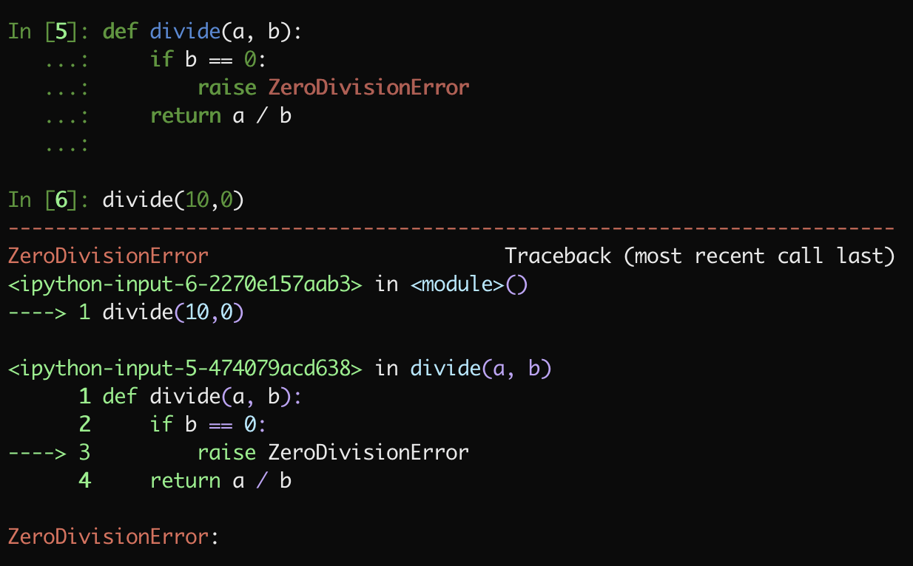
Exception Raise Qilish

Slide 10
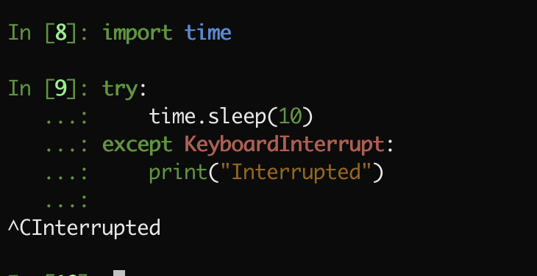
Keyboard Interrupt Event

